Slide 1
Unit 05 Notes
Cellular Division

Slide 2
Unit 05 Latin Root Words

Slide 3
Latin Root Words
Latin Root Word | Definition
Chromo | Color
Some | Body
Centro | Center
Mere | Part
Kine | To Move
Di | Double
Hap | Single
Tetra | Four
Homo | Same
10. Logos | Proportion or ratio
11. Mei | To lessen

Slide 4
Objective 1
I can explain the importance of cell division to living things

Slide 5
Why do cells divide?
Write
Reproduction
Growth and Development - all multi-cell creatures start out as a single cell
3. Repair and Replacement
- millions of our cells die and are replaced every second of every day

Slide 6
Replication via Mitosis Video
https://www.youtube.com/watch?v=m73i1Zk8EA0

Slide 7
Bacteria Growth
https://www.youtube.com/watch?v=gEwzDydciWc

Slide 8
Growth and Development Video
https://www.youtube.com/watch?v=P1h611sNji8

Slide 9
Repair and Replacement Video
https://www.youtube.com/watch?v=Cf3c5Um5gHc

Slide 10
Why can’t we regenerate limbs?
https://www.youtube.com/watch?v=QFa6jP6WgzM

Slide 11
Chromosomes
Objective 2: I know the two components that make up a chromosome.

Slide 12
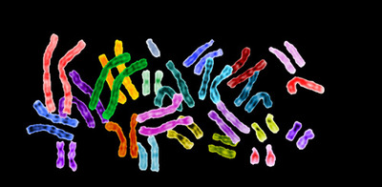
Chromosomes

Slide 13
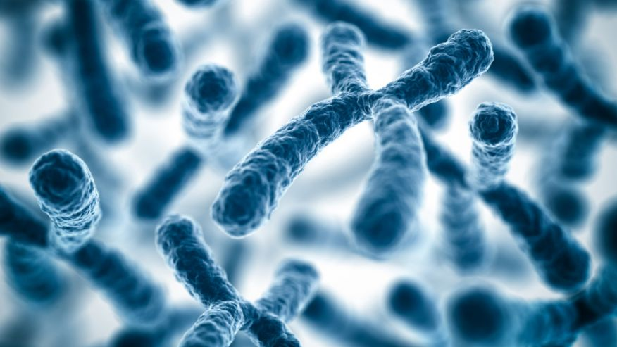
Chromosome
Write
*Chromosome:
DNA and proteins tightly coiled together

Slide 14
Did you Know:
If you put all the DNA molecules in your body end to end, the DNA would reach from the Earth to the Sun and back over 600 times (100 trillion times six feet divided by 92 million miles)

Slide 15
Activity
In every cell of your body is about 6 feet of DNA!
How does it all fit?
Try to fit your DNA (string) into your Nucleus (Circle on Paper)
You can try using some proteins (beads) to help you out.

Slide 16
Chromosome Condensation
Objective 3: I know the four levels of condensation for DNA.

Slide 17
Chromosome Parts
DNA
A nucleic acid that contains the information for our genes.

Slide 18
Chromosome Vocabulary
Nucleosome
DNA wrapped around a protein called Histone

Slide 19
Chromosome Vocabulary
Chromatin
DNA and proteins wound up together into a cord like structure

Slide 20
Chromosome Vocabulary
Chromosome
Coiled up Chromatin

Slide 21
Building a Chromosome
Write
DNA
Nucleosome
Chromatin
Chromosome
1. DNA is wound around the protein histone
2. Nucleosomes pack together to become chromatin
3. Chromatin packs together to become chromosomes

Slide 22
Diploid and Haploid Cells
Objective 4: I know the difference between Haploid and Diploid Cells

Slide 23
Humans = 23 Chromosomes
Fruit Fly = 4 Chromosomes
Carp = 52 Chromosomes
Adders tongue = 63 Chromosomes
Dog = 39 Chromosomes

Slide 24
Chromosome Sets
Write
*Every organism has a unique number of chromosomes.
Ploidy
the number of sets of chromosomes in a cell
Haploid Number (1N)
The number of chromosomes in a single set

Slide 25
Building Words
2 Sets of chromosomes
DI – PLOID =
HAP –PLOID =
1 Sets of chromosomes

Slide 26
Fruit Fly Chromosomes
The Fruit Fly has 4 distinct chromosomes.
1 Chromosome Set

Slide 27
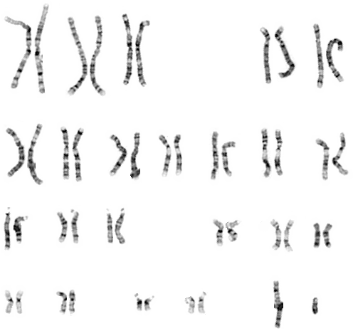
Human Chromosomes
Chromosomes from a DIPLOID Cell
How many chromosomes are there?
46
How many would there be in a HAPLOID CELL?
23
What is the Haploid Number for Humans
23

Slide 28
Haploid and Diploid Cells
Write
*Different Cells have different number of sets of chromosomes.
Haploid (1N)
Diploid
(2N)
A haploid cell has 1 set of chromosomes.
A diploid cell has 2 set of chromosomes.
*The Majority of your cells have two sets of chromosomes and are considered to be diploid.

Slide 29
Write
All Cells
No Nucleus
Nucleus
Prokaryotic
Eukaryotic
Plant
Animal
Haploid
Diploid
Haploid
Diploid

Slide 30
Other Names for Haploid And Diploid Cells
Write
Haploid Cells
Sex Cells
Sperm (male)
Egg (female)
Gametes
Germ Cells
Diploid Cells
Body Cells
Somatic Cells
Liver, Skin, Brain, etc.

Slide 31
Chromosome Worksheet
Do 1-20
Do not turn in when you are done.
Ask for Ms. Roderick to check
We will complete the rest of the worksheet on Tuesday.

Slide 32
Homologous Chromosomes
Objective 5. I can describe what makes two chromosomes homologous

Slide 33
Where do your Chromosome sets come from?
1 set comes from your mother
1 set comes from your father

Slide 34
Homologous Chromosomes
Listen
Homologous Chromosomes
Homologous Chromosomes
Homologous Chromosomes
Homologous Chromosomes

Slide 36
Homologous Chromosomes
Write
Homo = Same Logous = Ratio
Homologous chromosomes are from different sets. They have the same shape and the same type of genes on them.
Only found in cells with more than one set (diploid, triploid, quadraploid)
Homologous Chromosomes
Homologous Chromosomes
Homologous Chromosomes
Homologous Chromosomes

Slide 37
Homologous Chromosomes Practice
http://www.execulink.com/~ekimmel/karyotype_drag_and_drop.swf

Slide 38
Types of Chromosomes
Objective 6. I know the two types of chromosomes

Slide 39
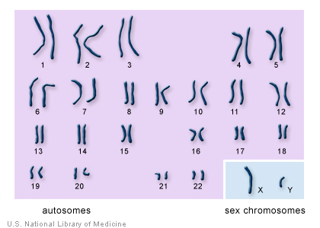
Types of Chromosomes
Write
Autosomes
Any chromosomes not considered a sex chromosome or is not involved in sex determination.
Sex Chromosomes
a chromosome involved with determining the sex of an organism. X or Y in humans.

Slide 40
Gender Determination
Write
Two X chromosomes (XX) = Girl
1 X and 1 Y Chromosomes (XY) = Boy

Slide 41
Karyotypes
Objective 7. I know what a karyotype is and how it can be used to find diseases.

Slide 42
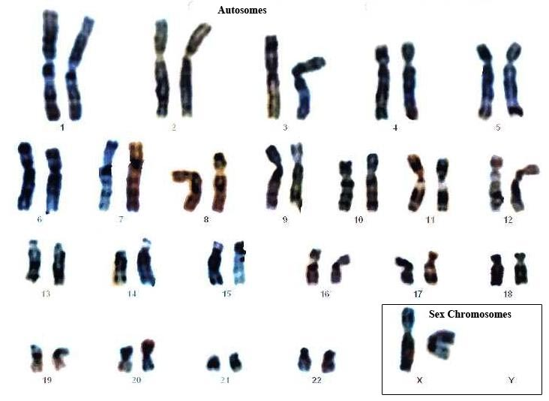
This is a human karyotype. How many chromosomes do humans have?
23 chromosome pairs
46 chromosomes

Slide 43
Karyotypes
Write
Karyotype – a picture of all the chromosomes in the cell of an organism matched up with their homologous pairs.

Slide 44
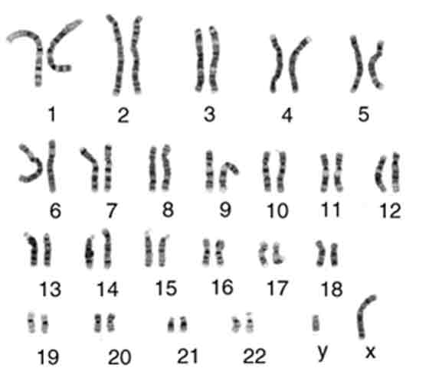
Human Karyotype

Slide 45
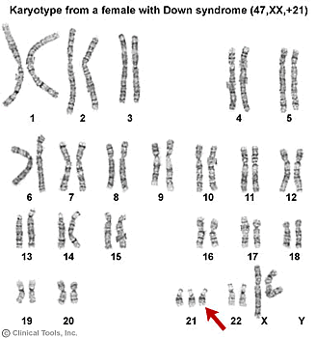

Slide 46
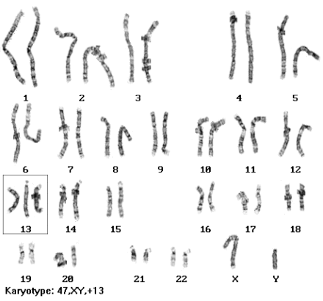
Patau syndrome (trisomy 13): serious eye, brain, circulatory defects as well as cleft palate. 1:5000 live births. Children rarely live more than a few months.

Slide 47
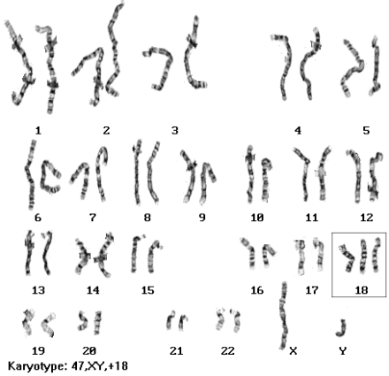
Edward's syndrome (trisomy 18): almost every organ system affected 1:10,000 live births. Children with full Trisomy 18 generally do not live more than a few months.

Slide 48
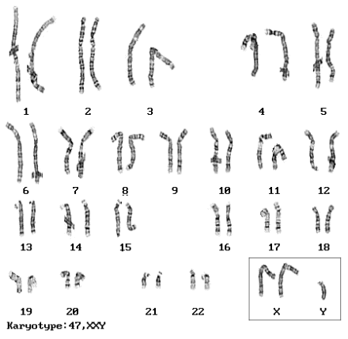
Klinefelter syndrome: 47, XXY males. Male sex organs; unusually small testes, sterile. Breast enlargement and other feminine body characteristics. Normal intelligence.

Slide 49
Human Chromosomes
Objective 8. I know the Ploidy or (set) number of chromosomes for humans.

Slide 50
Humans
All human cells, except for gametes, are diploid.
They have 2 sets of 23 chromosomes (Haploid Number = 23)
1 set comes from your father
1 set comes from your mother
Humans have two sets of chromosomes
Two sets of 23 for a total of 46 chromosomes

Slide 51
Chromosome
Write me a half page on everything you’ve learned about Chromosomes so far.
5-10 Minutes
Turn it into the basket when you are done.

Slide 52
Types of Reproduction
Objective 9. I can describe the difference between asexual and sexual reproduction.

Slide 53
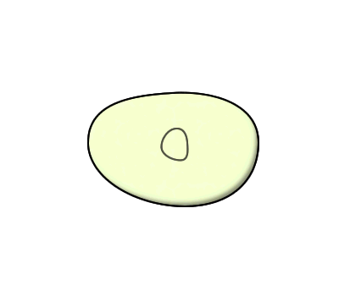
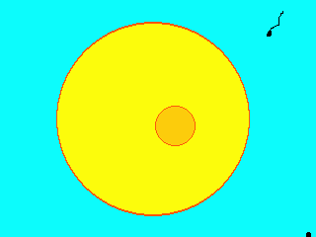
Two Types of Reproduction
Asexual Reproduction
Making a copy
Offspring are identical
2N → 2N
Sexual Reproduction
Reproduction with the fusion of gametes
Creates a unique offspring
1N + 1N = 2N

Slide 54
Fertilization
Objective 10. I can describe what fertilization is.

Slide 55
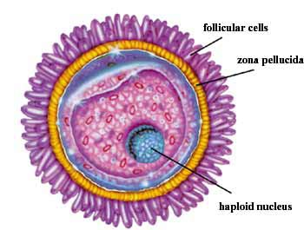
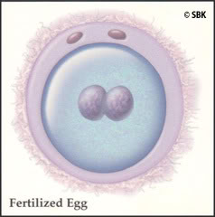
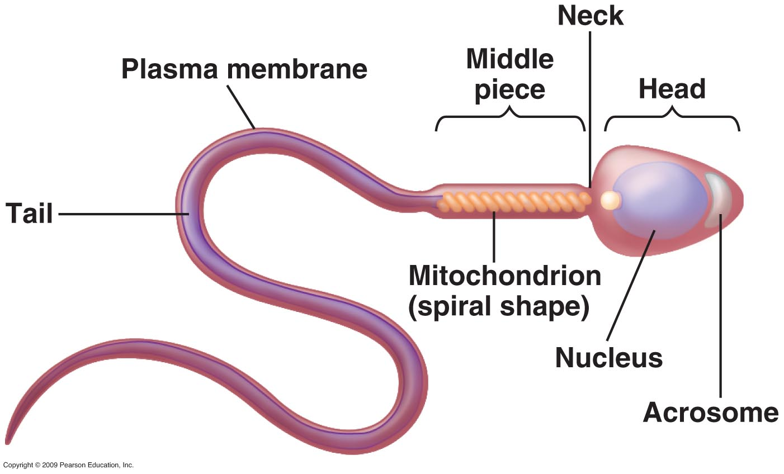
Fertilization
Fertilization
the action or process of fertilizing an egg via the fusion of the male sperm with the female egg to form a zygote.
Zygote
a diploid cell resulting from the fusion of two haploid gametes; a fertilized egg.

Slide 56
Fertilization Video
https://www.youtube.com/watch?v=BFrVmDgh4v4

Slide 57
Finish Chromosome Number Worksheet
Work on your Chromosome Number Worksheet
Turn it into the basket when you are done
Ova = egg

Slide 58
The Cell Cycle
11. I know the major phases of the cell cycle and what happens in each.

Slide 59
Cell Cycle:
Cell Cycle:
Interphase:
Gap 1
G1
Synthesis Phase
S
Gap 2
G2
Chromatids and Chromosomes
Mitosis:
Prophase
Metaphase
Anaphase
Telophase
Kinetochore:
Centromere:
Centriole:
Cytokinesis:
Spindle Fiber:

Slide 60
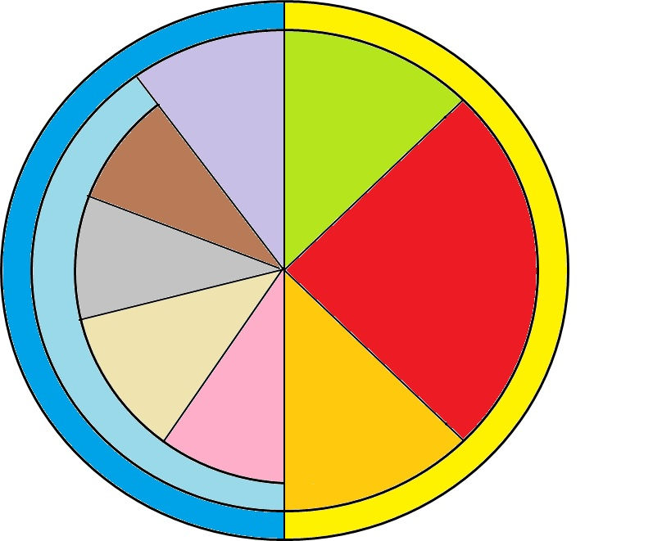
How do we know when Cell Division Occurs?
Cell Cycle
A series of events that take place in eukaryotic cells leading to their division and duplication
G1 Phase
Cytokinesis
Telophase
M-Phase
Mitosis
Interphase
Anaphase
S Phase
Metaphase
Prophase
G2 Phase

Slide 61
Cell Cycle:
Cell Cycle: A series of events that take place in eukaryotic cells leading to their division and duplication
Interphase:
Gap 1
G1
Synthesis Phase
S
Gap 2
G2
Chromatids and Chromosomes
Mitosis:
Prophase
Metaphase
Anaphase
Telophase
Kinetochore:
Centromere:
Centriole:
Cytokinesis:
Spindle Fiber:

Slide 62
The Two Major Phases of the Cell Cycle
Interphase
The resting phase between mitosis or meiosis
M Phase
The phase where mitosis (or meiosis) and cytokinesis occurs.
Cytokinesis
G1 Phase
Telophase
M-Phase
Mitosis
Interphase
Anaphase
S Phase
Metaphase
Prophase
G2 Phase

Slide 63
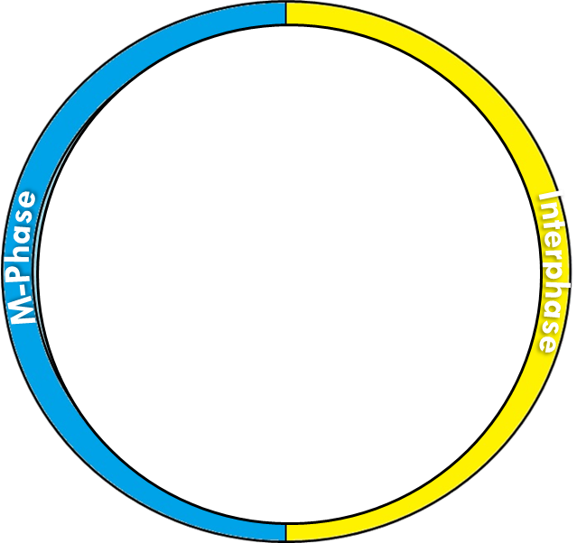
Cell Cycle:
Cell Cycle: A series of events that take place in eukaryotic cells leading to their division and duplication
Interphase: The resting phase between mitosis or meiosis
Gap 1
G1
Synthesis Phase
S
Gap 2
G2
Chromatids and Chromosomes
Mitosis:
Prophase
Metaphase
Anaphase
Telophase
Kinetochore:
Centromere:
Centriole:
Cytokinesis:
Spindle Fiber:

Slide 64
What are the three phases of Interphase?
G1 – Gap 1 – Phase
Gap 1 phase – cell grows
S Phase
Synthesis phase – DNA makes a copy of itself
2N → 4N
G2 – Gap 2 – Phase
Gap 2 phase - organelles replicate
G1 Phase
S Phase
2N → 4N
Interphase
G2 Phase

Slide 65
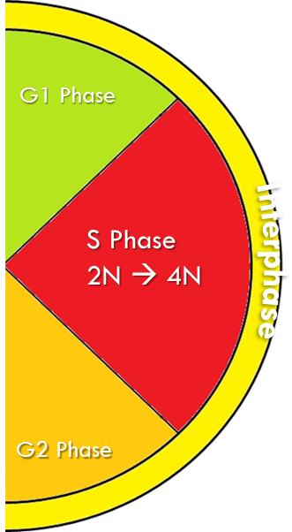
Cell Cycle:
Cell Cycle: A series of events that take place in eukaryotic cells leading to their division and duplication
Interphase: The resting phase between mitosis or meiosis
Gap 1
G1
cell grows
Synthesis Phase
S
DNA makes a copy of itself
2N → 4N
Gap 2
G2
organelles replicate
Chromatids and Chromosomes
Mitosis:
Prophase
Metaphase
Anaphase
Telophase
Kinetochore:
Centromere:
Centriole:
Cytokinesis:
Spindle Fiber:

Slide 66
S Phase and Chromosomes
Centromere: Center Part that binds two sister chromatids together.
Kinetechore: an area on a chromosome where spindle fibers attach to help move the sister chromatids apart.
Sister Chromatid (original)
Sister Chromatid (copy)
Chromosome
Chromosome

Slide 67
Cell Cycle:
Cell Cycle: A series of events that take place in eukaryotic cells leading to their division and duplication
Interphase: The resting phase between mitosis or meiosis
Gap 1
G1
cell grows
Synthesis Phase
S
DNA makes a copy of itself
2N → 4N
Gap 2
G2
organelles replicate
Chromatids and Chromosomes
Mitosis:
Prophase
Metaphase
Anaphase
Telophase
Kinetochore: an area where spindle fibers attach to help move the sister chromatids apart.
Centromere: Center Part that binds two sister chromatids together.
Centriole:
Cytokinesis:
Spindle Fiber:

Slide 68
S Phase and Chromosomes
After S Phase
Before S Phase
Centromere
Centromere
Kinetochore
Kinetochore
Sister Chromatid (original)
Sister Chromatid (copy)
Chromatid
Chromosome

Slide 69
CHROMATIN
COILED UP DNA
FIBER
CHROMATID
COILED UP DNA UNCOPIED CHROMOSOME
CHROMOSOME ORIGINAL AND COPIED COILED UP DNA

Slide 70
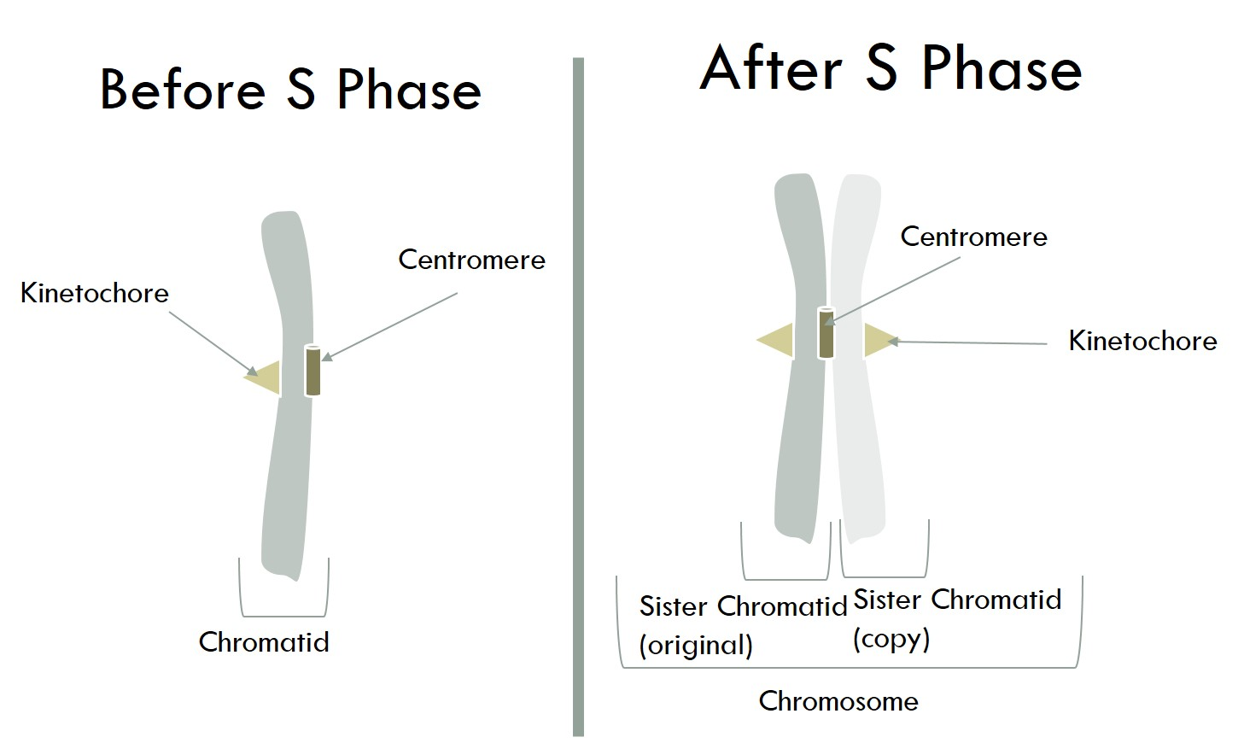
Cell Cycle:
Cell Cycle: A series of events that take place in eukaryotic cells leading to their division and duplication
Interphase: The resting phase between mitosis or meiosis
Gap 1
G1
cell grows
Synthesis Phase
S
DNA makes a copy of itself
2N → 4N
Gap 2
G2
organelles replicate
Chromatids and Chromosomes
Mitosis:
Prophase
Metaphase
Anaphase
Telophase
Kinetochore: an area where spindle fibers attach to help move the sister chromatids apart.
Centromere: Center Part that binds two sister chromatids together.
Centriole:
Cytokinesis:
Spindle Fiber:

Slide 71
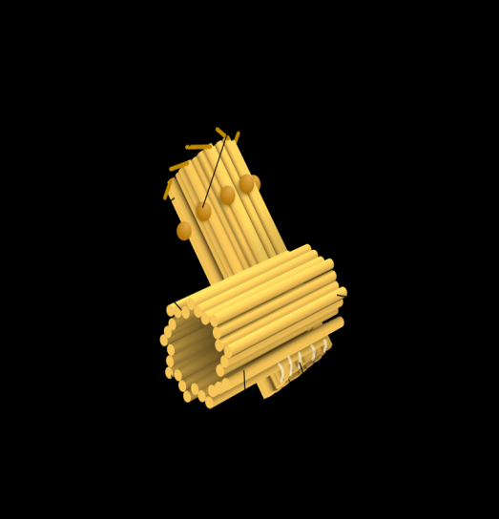
Mitosis Organelles Vocabulary
Centriole
An organelle that organizes the spindle fibers that assist in mitosis and cytokinesis.
Spindle Fibers
Fibers that attach to a kinetechore and pulls the two chromatids apart.

Slide 72
Chromosome Structure
Spindle Fibers
Spindle Fibers
Centromeres
Centriole
Centriole
Kinetechore
Kinetechore
Original Chromatid
Copied Chromatid
Chromosome

Slide 73
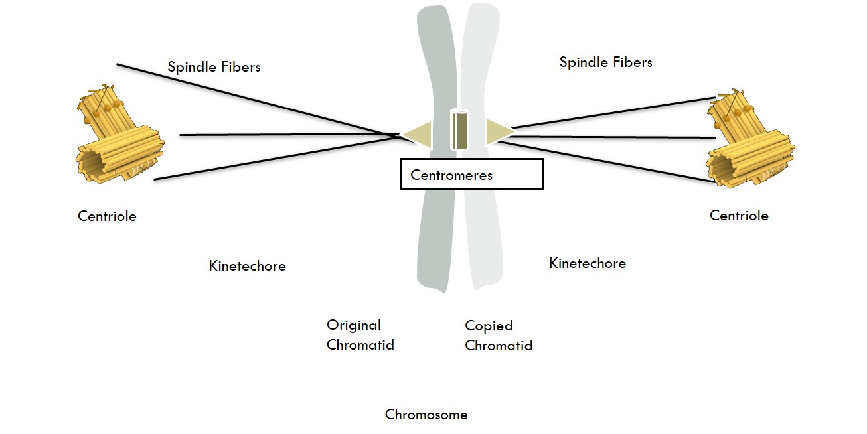
Cell Cycle:
Cell Cycle: A series of events that take place in eukaryotic cells leading to their division and duplication
Interphase: The resting phase between mitosis or meiosis
Gap 1
G1
cell grows
Synthesis Phase
S
DNA makes a copy of itself
2N → 4N
Gap 2
G2
organelles replicate
Chromatids and Chromosomes
Mitosis:
Prophase
Metaphase
Anaphase
Telophase
Kinetochore: an area where spindle fibers attach to help move the sister chromatids apart.
Centromere: Center Part that binds two sister chromatids together.
Centriole: An organelle that organizes the spindle fibers that assist in mitosis and cytokinesis.
Cytokinesis:
Spindle Fiber: Fibers that attach to a kinetechore and pulls the two chromatids apart

Slide 74
What are the two phases of M-Phase?
Mitosis
Division of the Nucleus
Cytokinesis
Division of the entire cell
Cytokinesis
G1 Phase
Telophase
M-Phase
Mitosis
Interphase
Anaphase
S Phase
Metaphase
Prophase
G2 Phase

Slide 75
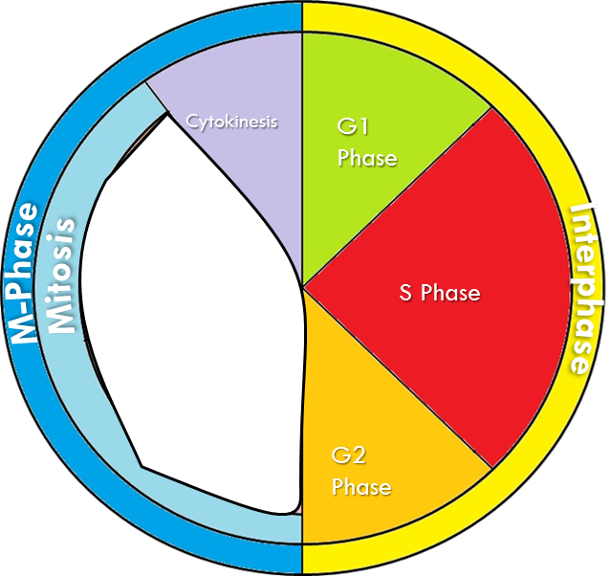
Cell Cycle:
Cell Cycle: A series of events that take place in eukaryotic cells leading to their division and duplication
Interphase: The resting phase between mitosis or meiosis
Gap 1
G1
cell grows
Synthesis Phase
S
DNA makes a copy of itself
2N → 4N
Gap 2
G2
organelles replicate
Chromatids and Chromosomes
Mitosis: Division of the Nucleus
Prophase
Metaphase
Anaphase
Telophase
Kinetochore: an area where spindle fibers attach to help move the sister chromatids apart.
Centromere: Center Part that binds two sister chromatids together.
Centriole: An organelle that organizes the spindle fibers that assist in mitosis and cytokinesis.
Cytokinesis: Division of the entire cell
Spindle Fiber: Fibers that attach to a kinetechore and pulls the two chromatids apart

Slide 76
What are the Four Phases of Mitosis?
PMAT
Prophase
Metaphase
Anaphase
Telophase
Cytokinesis
G1 Phase
Telophase
M-Phase
Mitosis
Interphase
Anaphase
S Phase
Metaphase
Prophase
G2 Phase

Slide 77
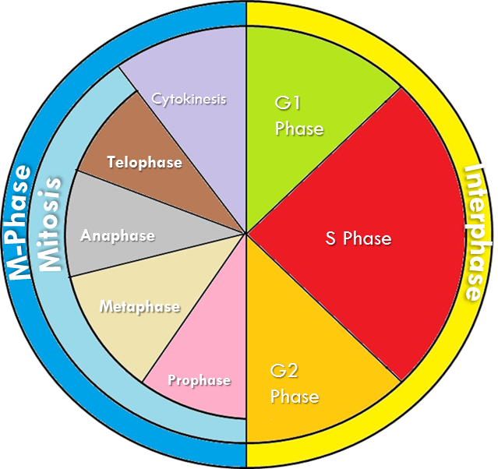
Cell Cycle:
Cell Cycle: A series of events that take place in eukaryotic cells leading to their division and duplication
Interphase: The resting phase between mitosis or meiosis
Gap 1
G1
cell grows
Synthesis Phase
S
DNA makes a copy of itself
2N → 4N
Gap 2
G2
organelles replicate
Chromatids and Chromosomes
Mitosis: Division of the Nucleus
Prophase
P
Metaphase
M
Anaphase
A
Telophase
T
Kinetochore: an area where spindle fibers attach to help move the sister chromatids apart.
Centromere: Center Part that binds two sister chromatids together.
Centriole: An organelle that organizes the spindle fibers that assist in mitosis and cytokinesis.
Cytokinesis: Division of the entire cell
Spindle Fiber: Fibers that attach to a kinetechore and pulls the two chromatids apart

